Slide 1
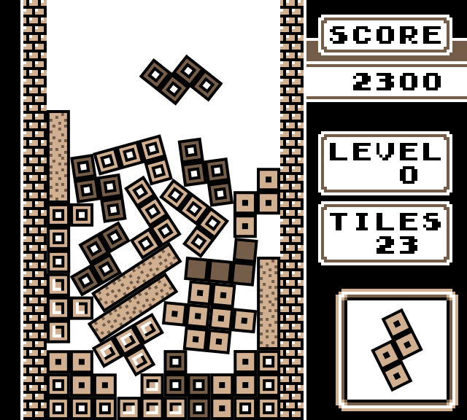
Count of Monte Carlo
Applying Monte Carlo Tree Search to Tetris
Samir Khays | Kevin Holdcroft | Yoshua Nava | Viktor Tuul

Slide 2

Contents
Problem Introduction
Methods
Search tree representation
State transition function
Monte Carlo Tree Search
Heuristics
Results
Future Work
Title Image Source: http://stabyourself.net/images/screenshots/nottetris2-1.png
KTH Image Source: https://project-sparks.eu/wp-content/uploads/2014/04/KTH_Logotyp_RGB_2013.jpg
Notes:
30 sec

Slide 3
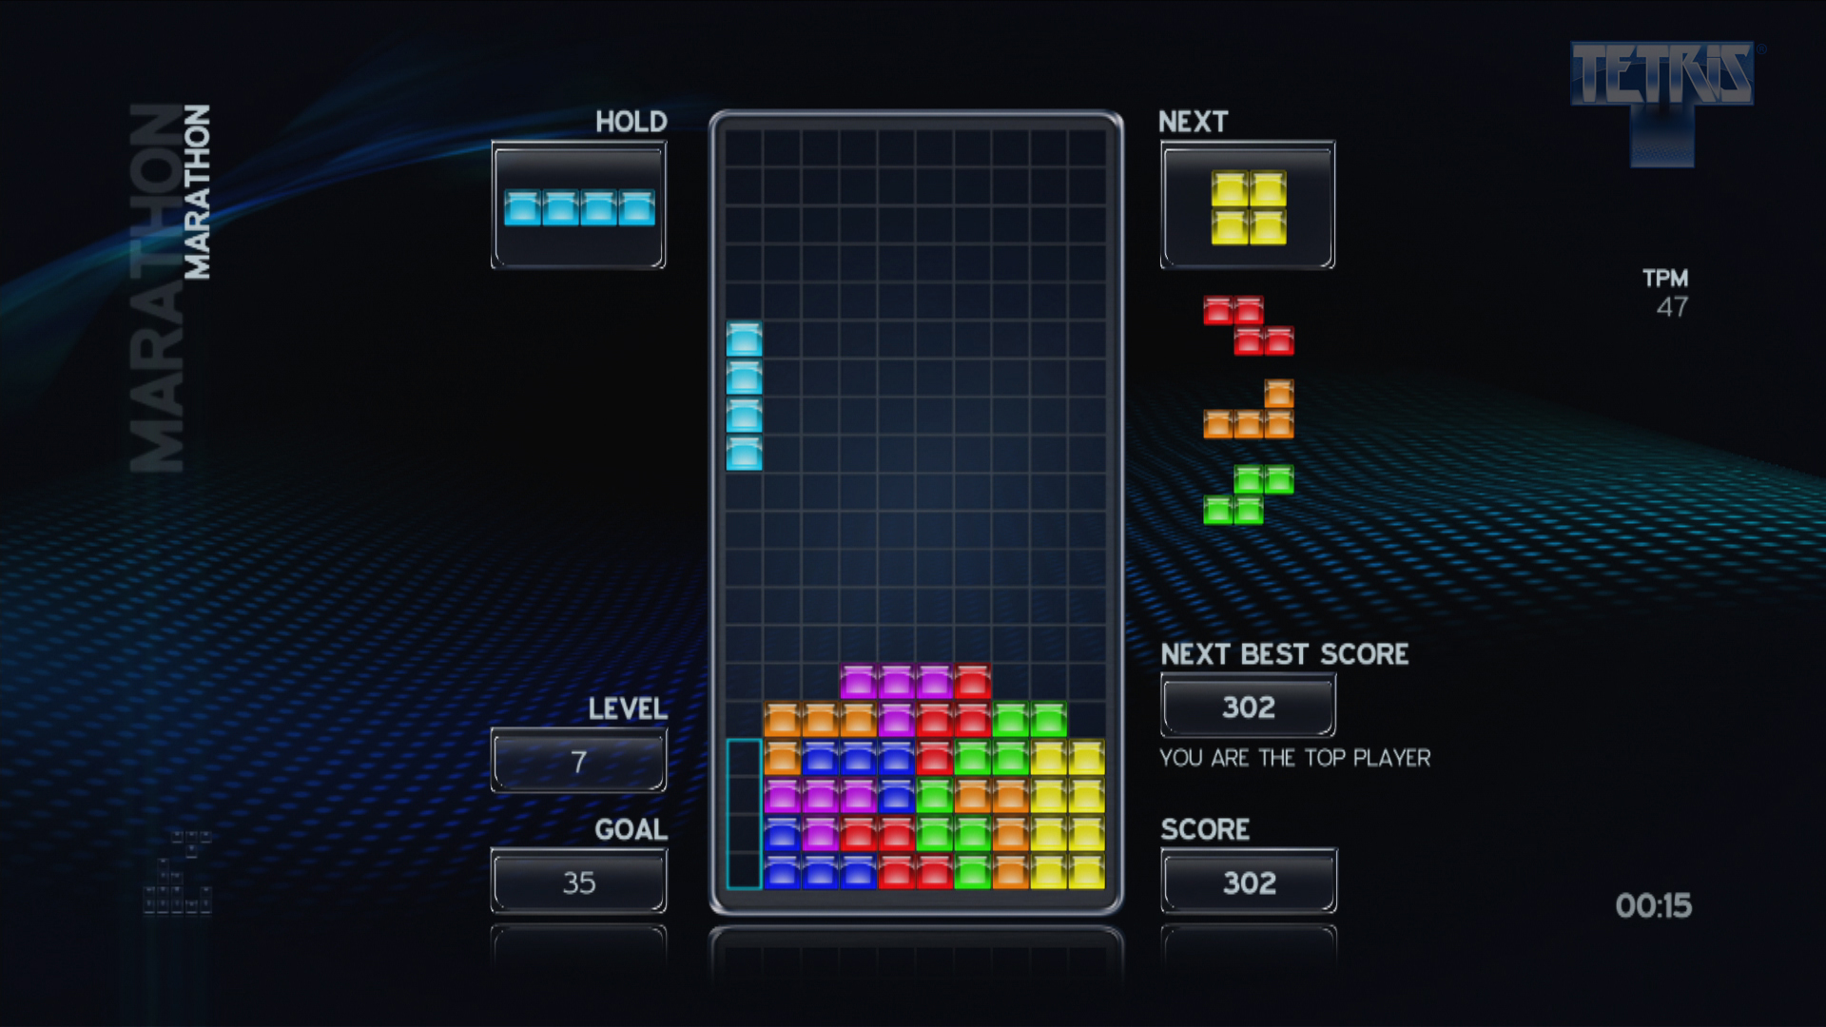
Tetris
Classic video game
Guide 7 types of pieces onto a grid
Goal to fill rows completely
Full rows disappear
Know only current and next piece
Depending on variant
Stochastic, non-deterministic
Image Source: http://mashthosebuttons.com/gallery/tetris_psn/marathon_hi_res.jpg

Slide 4
Work done
Implemented two different AI capable of playing Tetris
Monte Carlo Tree Search (MCTS)
Breadth-First Search (BFS)
Originally implemented MCTS
Project goal
BFS used to tune heuristics
Ended up performing excellently

Slide 5
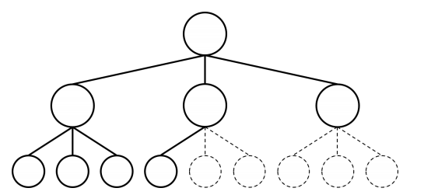
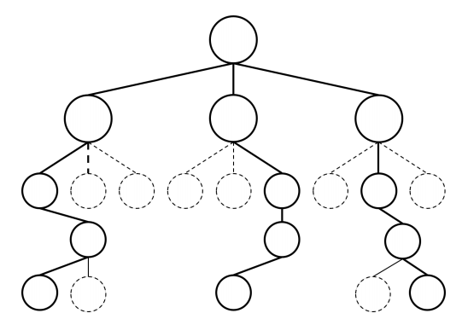
Search tree representation
Search tree algorithm utilization
Represent the game in a search tree
Nodes being the current and possible future game states
Search utilizing Breadth First Search
State transition function
Needed in order to produce a search tree
Was not included in the open source game
Search utilizing Monte Carlo Tree Search

Slide 6
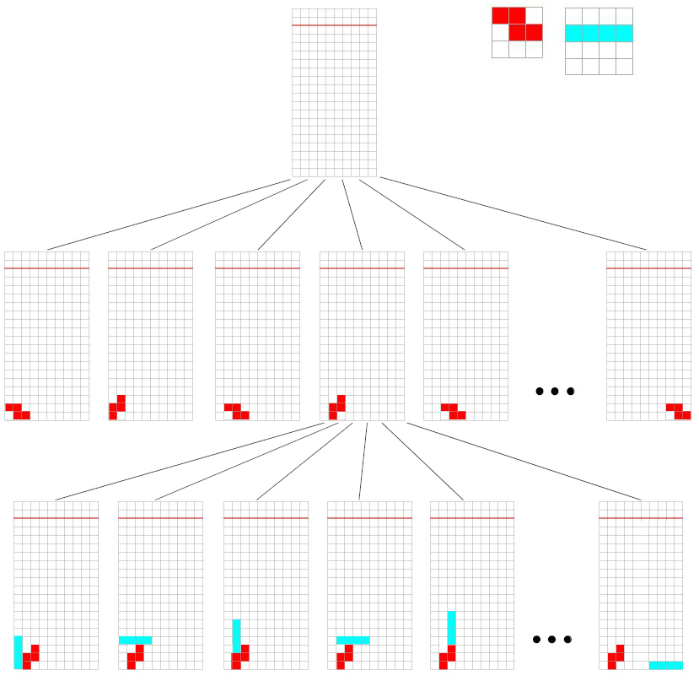
State transition function
State transition function
Given any state (board + falling brick) → get every possible child state
In practice: copies of the game and simulations for every brick orientation/place combination
Assignment of randomly chosen bricks → MCTS
source: http://totologic.blogspot.se/2013/03/tetris-ai-explained.html

Slide 7
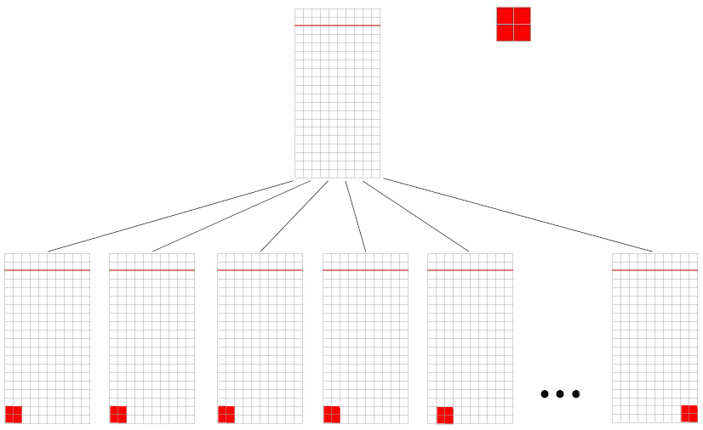
Avoidance of duplicate states
Local hash tables
Efficiency when expanding child nodes (avoidance of duplicate states)
Example: square block rotations
Rotations of the square corresponds to the same state

Slide 8
MCTS
MCTS
Start -> Sampling -> Expansion -> Simulation -> Backprop -> Start
Sampling criteria: UCB1.
For simulation:
First, tried out random (light) playouts.
Then heavy playouts with our BFS.
Performance limitations for deeper search.
Winning condition in Tetris? Design decision.
Notes:
30 sec

Slide 9
Heuristics
Number of holes
Aggregate height
Cleared lines
KTH Image Source: https://project-sparks.eu/wp-content/uploads/2014/04/KTH_Logotyp_RGB_2013.jpg
Notes:
30 sec

Slide 10
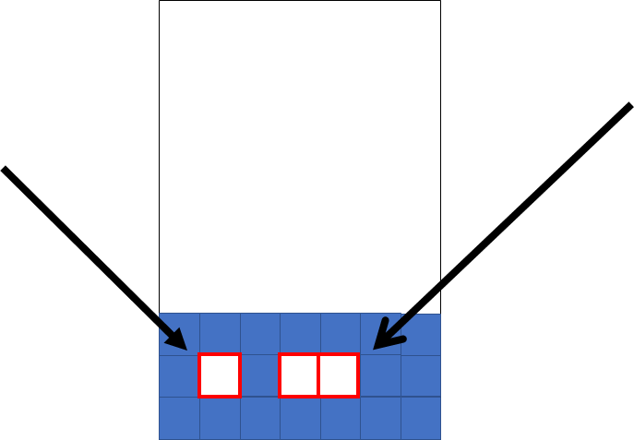
The Number of Holes heuristic
KTH Image Source: https://project-sparks.eu/wp-content/uploads/2014/04/KTH_Logotyp_RGB_2013.jpg
Notes:
30 sec

Slide 11
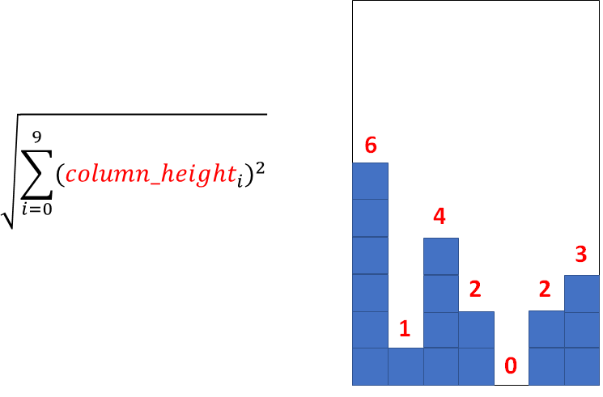
The Aggregate Height heuristic
KTH Image Source: https://project-sparks.eu/wp-content/uploads/2014/04/KTH_Logotyp_RGB_2013.jpg
Notes:
30 sec

Slide 12
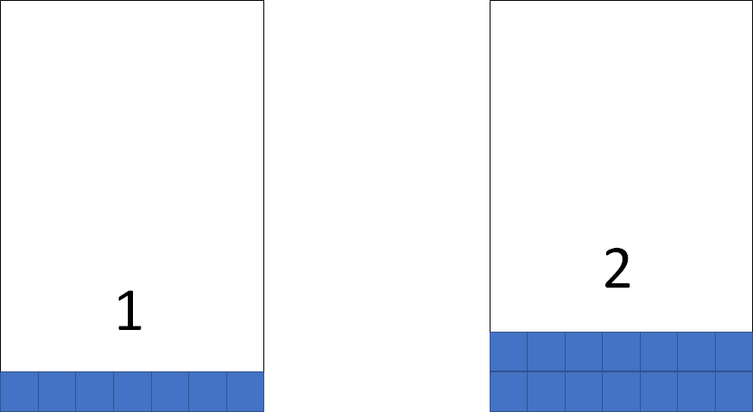
The Cleared Lines heuristic
KTH Image Source: https://project-sparks.eu/wp-content/uploads/2014/04/KTH_Logotyp_RGB_2013.jpg
Notes:
30 sec

Slide 13
Results
Method | Lines Cleared | Score
BFS (depth 2) | 93 | 11820
BFS (depth 1) | 40 | 5770
MCTS | 27 | 3820

Slide 14
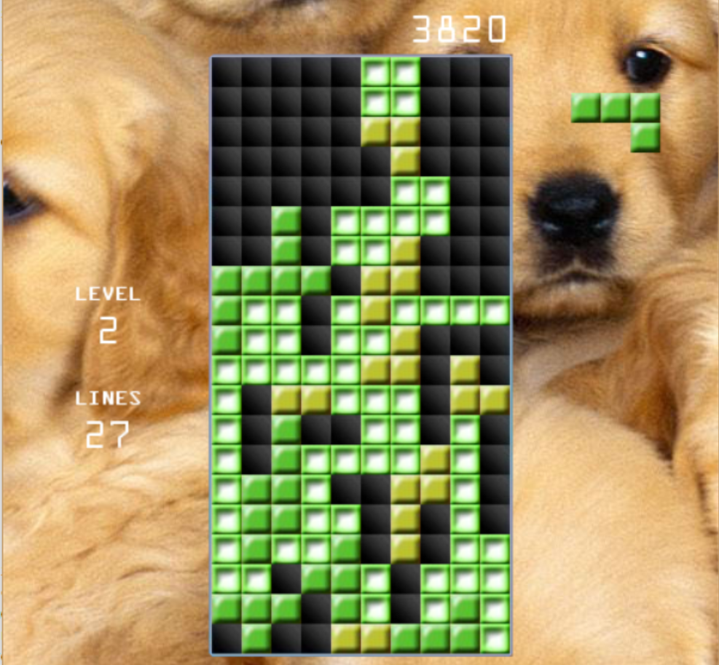
Results MCTS

Slide 15
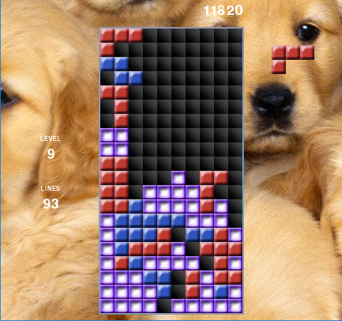
Results BFS (depth 2)

Slide 16
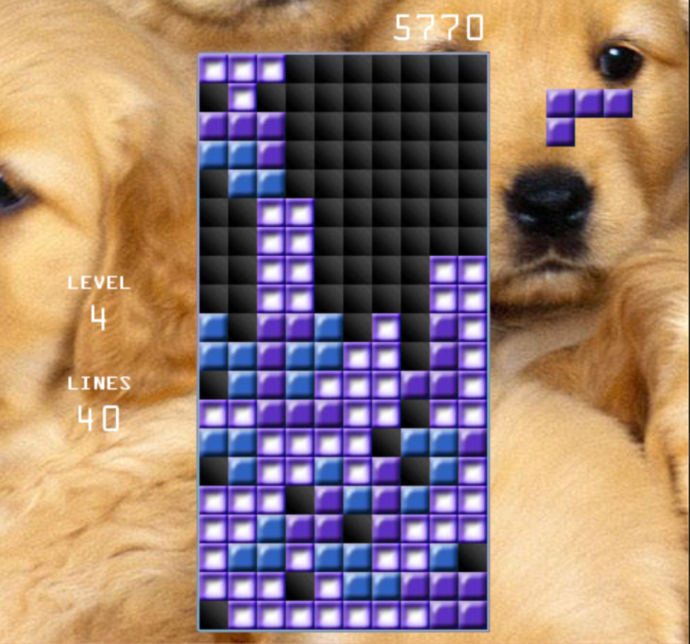
Results BFS (depth 1)

Slide 17
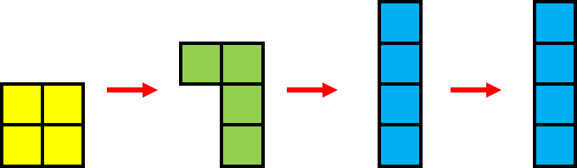
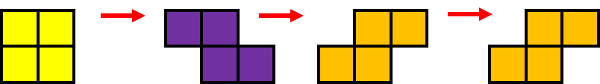
Discussion
Believe MCTS biased by having random paths with ideal piece drops
Will move based on anticipation of future pieces
e.g. two straight pieces in a row
Tetris is stochastic
When pieces never come, past move is in a bad spot
“Counting chickens before they hatch”
Performance limitations
Explored Path (returns good heuristics)
Actual future pieces

Slide 18
Discussion
BFS works since it tries to optimize the map based on current piece
Current heuristics try to make the best possible map
Only works with what it already has
Similar to how actual people play
MCTS robust to pieces, rather than to map state
Attempts to place piece in a way to optimize random child states
Theoretically valid, but biased toward piece choice

Slide 19
Future work
Play in Real-time
Could Improve MCTS
More Heuristics
Genetic Algorithms for Heuristics
Including MCTS ‘C’ value
Translate to cpp instead, or use pipes
Python too slow
Bug in the later stages of the game
Causes pieces to stack in a column to one side

Slide 20
Final Comments
MCTS catered towards scenarios when there is a clear advantage towards searching deep
Situations with few actions
Scenarios where actions can be undone based on new information
MCTS more suitable for games like Pac-Man
Thank-you to Professor Tumova and Professor Jensfelt for this class and for your insight
You TAs were great too

Slide 21

Questions?
KTH
VETENSKAP
OCH BLOCK

